Slide 1
Midterm2- review-homework

Slide 2
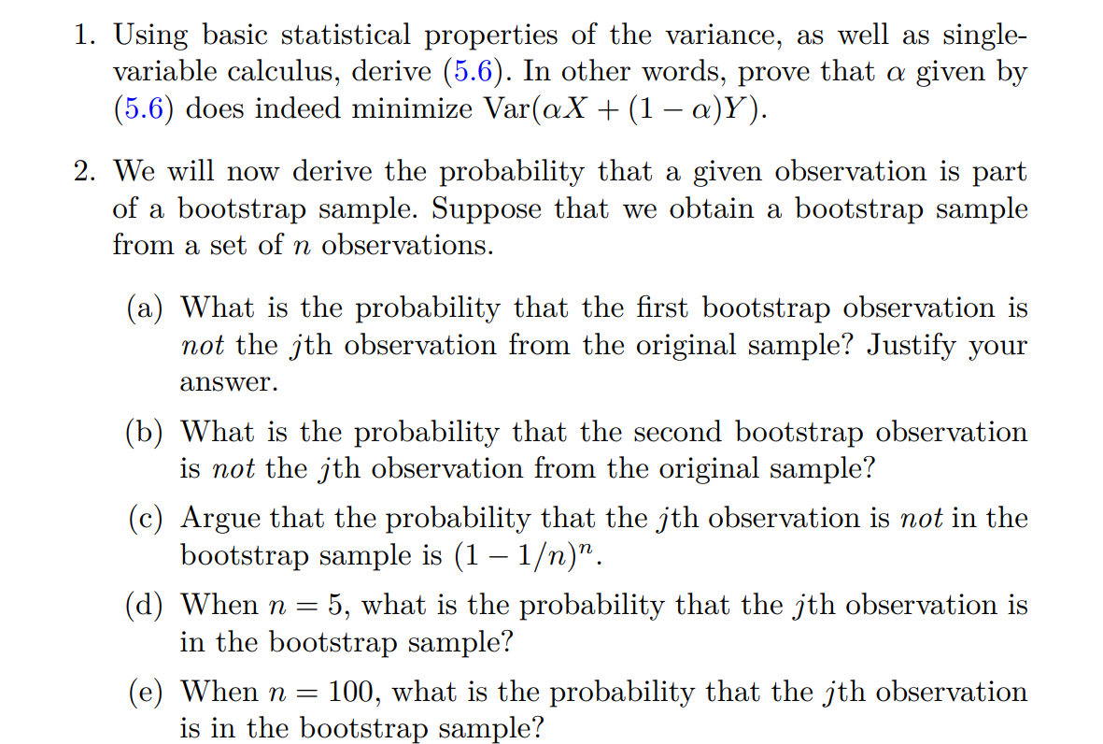
Hw 6: 5.4.1, 5.4.2

Slide 3
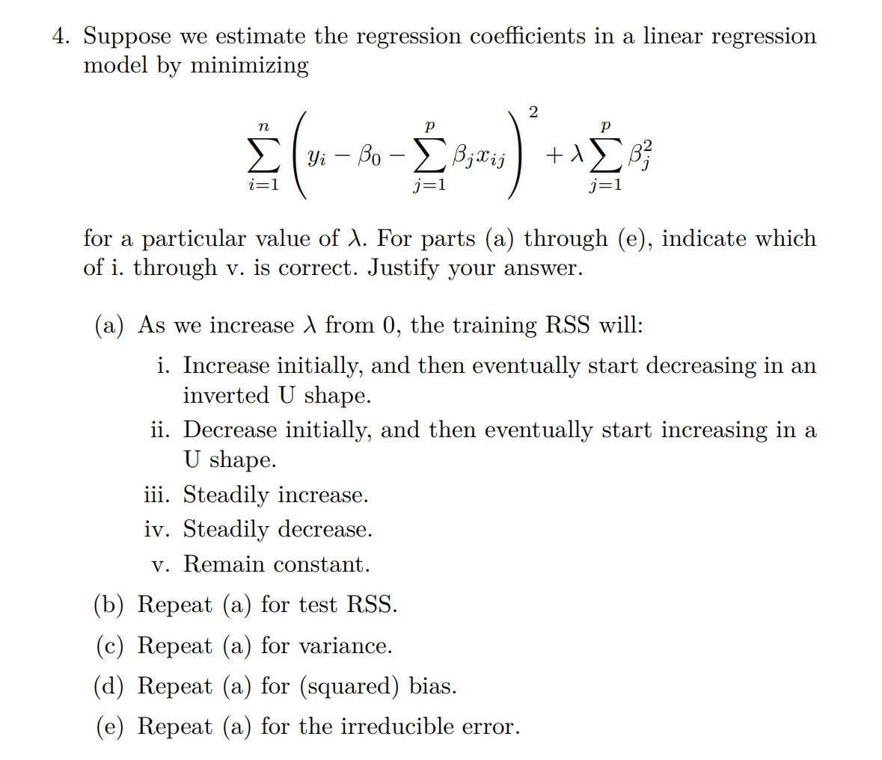
Hw 7: 6.6.4

Slide 4
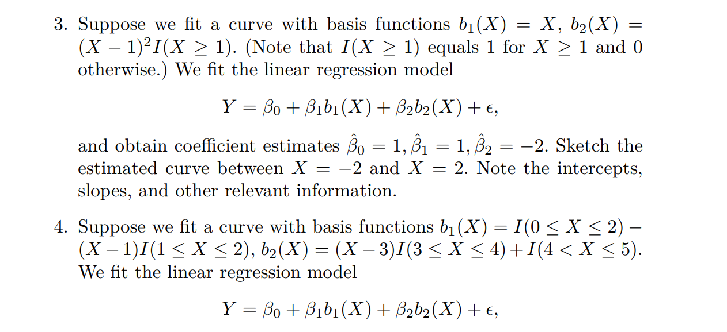
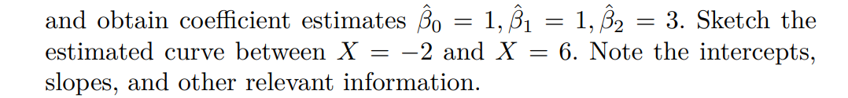



Hw 7: 7.9.3,7.9.4

Slide 5
Hw8: 7.9.1, 8.4.4

